Slide 1

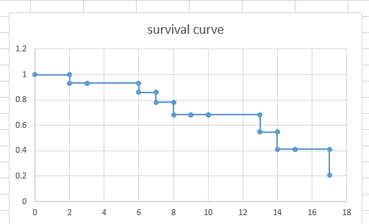

A Comparison Study of Random Survival Forest and Cox Proportional Hazards for Predicting the Survival Risk of 76-gene prognostic signature from breast cancer
UNIVERSITY OF MADRAS
KRITHIKA DEVI C (32820006)

Slide 2
OUTLINE
Introduction
Data Descriptive and Summary
Breast Cancer
Use of Genomic Data
Cox Proportional Hazard (CPH) model
Analysis on CPH
Random Survival Forest
Analysis on RSF
Prediction Performance
Comparison of CPH and RSF on Predictive ability
Conclusion

Slide 3
1. INTRODUCTION
This study provides an overview of statistical methods for the analysis of high-dimensional data with time-to-event endpoint analysis.
The identification of appropriate covariates and the adequate manipulation of non-linearity and high dimensionality are highly critical to investigate the effect of several important covariates on the event times and the accurate survival prediction.
In survival analysis many different regression modelling strategies can be applied to predict the risk of future events. Often, however, the default choice of analysis relies on Cox regression modelling due to its convenience.

Slide 4
The Cox proportional hazards (CPH) model seems to be the first natural step since it is the most commonly used method in modelling event times with the covariates. Its popularity is rooted in its simple interpretation, semi-parametric nature, that is, survival time models that have a fully parametric regression structure but leave their dependence on time unspecified.
The CPH model, however, may result in biased parameter estimates if the covariates fail to follow the proportional hazards assumption. Moreover, the assumption is often violated due to the presence of complex relationships in the data structure.

Slide 5
Extensions of the Random Survival Forest (RSF) approach to survival analysis provide an alternative way to build a risk prediction model. This approach is the use of classification and regression trees (CART) that gives a more detailed study of the effects of covariates on the survival distributions and allows for accurate prediction.
A RSF bypasses the need to impose parametric or semi-parametric constraints on the underlying distributions and provides a way to automatically deal with higher-order terms in variable that fit a linear combination of trees. The intended approaches of CPH and RSF were compared in terms of prognostic factor (risk factor) detections and prediction performance.

Slide 6
Several measures can be used to assess the resulting probabilistic risk predictions. Most popular is the rank statistics like the concordance index which equals the area under the ROC curve (AUC) for binary responses.
For event time outcome in survival analysis these measures can be estimated pointwise over time, where pioneering work was done by Heagerty, Lumley, and Pepe (2000) for time-dependent ROC analysis.
Performance curves are obtained by combining time pointwise measures. In this article we concentrate on prediction error curves that are time dependent estimates of AUC.

Slide 7
In this thesis, the CPH and RSF models are compared and contrasted using a benchmark breast cancer dataset that has 76-gene prognostic signature able to predict distant metastases in lymph node-negative (N-) patients. This contains about three-fourth of women who are 40 or older when they are diagnosed with an invasive breast cancer.
The expression level of 76 genes has an estrogen receptor which helps in the progression of breast cancer and also has the report of tumor size and tumor grade on the survival of breast cancer.

Slide 8
2. DATA DESCRIPTION AND SUMMARY
The data has been gathered from the GEO Gene Expression Omnibus from National Centre for Biotechnology Information (National Library of Medicine) which advances science and health by providing access to biomedical and genomic information.
The data that was accessed is the strong Time Dependence of the 76-Gene Prognostic Signature that was able to predict distant metastases in lymph node-negative (N-) breast cancer patients.

Slide 9
The data contains the expression levels of 76 genes, age, estrogen receptor status (er), tumor size, grade, days and status for 198 individuals.
The objective is to predict the time to distant metastasis and probabilistic risk predictions.
The Study data consists of 198 patient observations with 82 features. Of these 82 features, 2 features such as ‘days’ and ‘status’ were survival dependent variable.

Slide 10
Predictor Variables Levels/ IQR Variable name Total (n = 198)
Continuous:
76-gene expression IQR X200726_at, X200965_s_at, X201068_s_at, 8.678166
ID ref X201091_s_at, X201288_at, X201368_at, [14.38958;
X201663_s_at, X201664_at, X202239_at, 0.516942]
X202240_at, X202418_at, X202687_s_at,
X203391_at, X204014_at, X204015_s_at,
X204073_s_at, X204218_at, X204540_at,
X204631_at, X204740_at, X204768_s_at,
X204888_s_at, X205034_at, X205848_at,
X217019_at, X217102_at, X217404_s_at,
X206295_at, X207118_s_at, X208180_s_at,
X208683_at, X209500_x_at, X209524_at,
X209835_x_at, X209862_s_at, X210028_s_at,
X210314_x_at, X210593_at, X211040_x_at,

Slide 11
X211382_s_at, X211762_s_at, X211779_x_at,
X212014_x_at, X212567_s_at, X214806_at,
X214915_at, X214919_s_at, X215510_at,
X215633_x_at, X216010_x_at, X216103_at,
X216693_x_at, X219724_s_at, X220886_at,
X221028_s_at, X217471_at, X221241_s_at,
X217767_at, X221344_at, X217771_at,
X221634_at, X217815_at, X221816_s_at,
X218430_s_at, X221882_s_at, X218478_s_at,
X221916_at, X218533_s_at, X221928_at,
X218782_s_at, X218883_s_at, X218914_at,
X219340_s_at, X219510_at, X219588_s_at,
X203306_s_at
Age IQR age 46 [ 24; 60]
Tumor Size IQR size 2 [0.6; 5]

Slide 12
Period of days taken IQR days 4384 [125; 9108]
Survival Status 0/1 status 147/51
Factors:
Status of
Estrogen Receptor positive/negative er 134/64
Tumor Grade poorly differentiated/ grade 83/83/30/2
intermediate/
well differentiated/
unknown

Slide 13
The entire dataset does not contain non-null values. It has a float data type for 76-gene expression and tumor size. Also, it has an integer data type for remaining covariates except estrogen receptor status and tumor grade which consists of object (Character) data type.
To perform the CPH and RSF model for the estimation of survival prediction, fixed random samples of size 198 were considered and 178 datasets were generated, for each of the models. The datasets were considered for training and evaluation (i.e., 178 for training set and 20 for testing set). Performances of the CPH and RSF methods were compared based on measures of accuracy derived from the test set of 20 samples, for both the model settings.

Slide 14
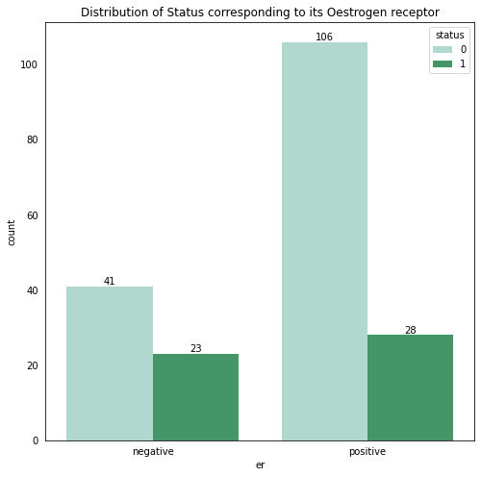
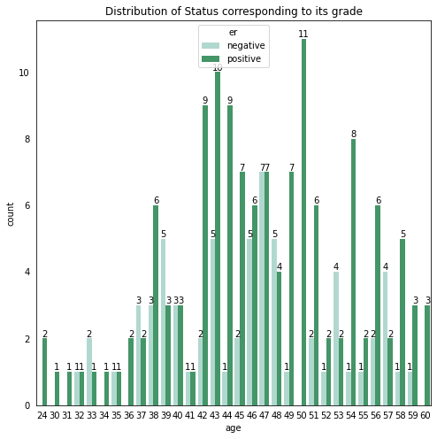
Figure 4.1: Distribution of Status
corresponding to its estrogen receptor.
Figure 4.1: Distribution of estrogen receptor
corresponding to its age.

Slide 15
3. BREAST CANCER
Breast cancer is a cancer that starts in breast tissue. It happens when cells in the breast change and grow out of control. The cells usually form a tumor.
In some cases, cancerous cells can invade surrounding breast tissue. In these cases, the condition is known as invasive breast cancer. Sometimes, tumors spread to other parts of the body. If breast cancer spreads, cancerous cells most often appear in the bones, liver, lungs, or brain. Tumors that begin at one site and then spread to other areas of the body are called metastatic cancers.
Breast cancer happens when there are changes in the genetic material (DNA).

Slide 16
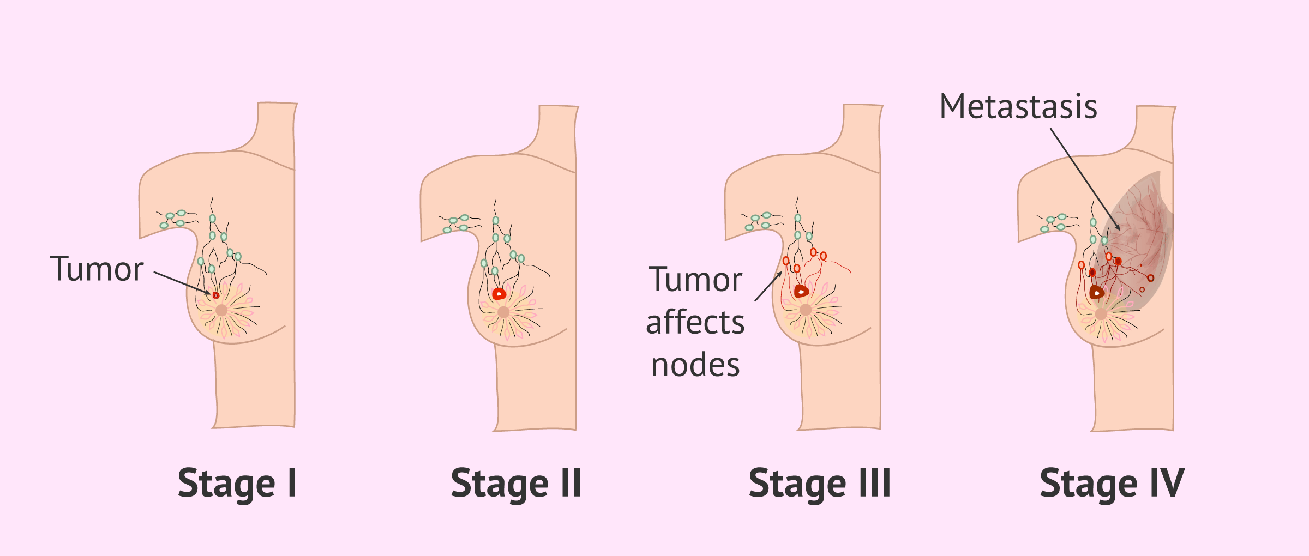
Breast cancer can be classified into different stages depending on several factors, such as tumor size, lymph node involvement, and metastasis.

Slide 17
3.1 Estrogen receptor - Positive and Negative Breast Cancer
Determination of estrogen receptor (ER) status on invasive carcinomas (cancer) prior to therapeutic procedures has become a standard practice in the management of breast cancer and approximately 60–65% of primary breast cancers are ER-positive.
Conversely, ER-negative tumors are more likely to be of higher histological grade, and the patients to have a decreased overall survival depending on age and lymph node status.

Slide 18
4. USE OF GENOMIC DATA
Genomic data science applies statistics and computer science to the genome. The goal is to understand, analyze, and interpret information from genome sequences.
Gene expression profiling has been used extensively in biological research and has resulted in significant advances in the understanding of the molecular mechanisms of complex disorders, including cancer, heart disease, and metabolic disorders.
The hope is that by analyzing patterns of gene expression (e.g. profiling) scientists will be able to better understand the molecular etiology of multi-factorial disorders such as obesity, diabetes, heart disease, or cancer.

Slide 19
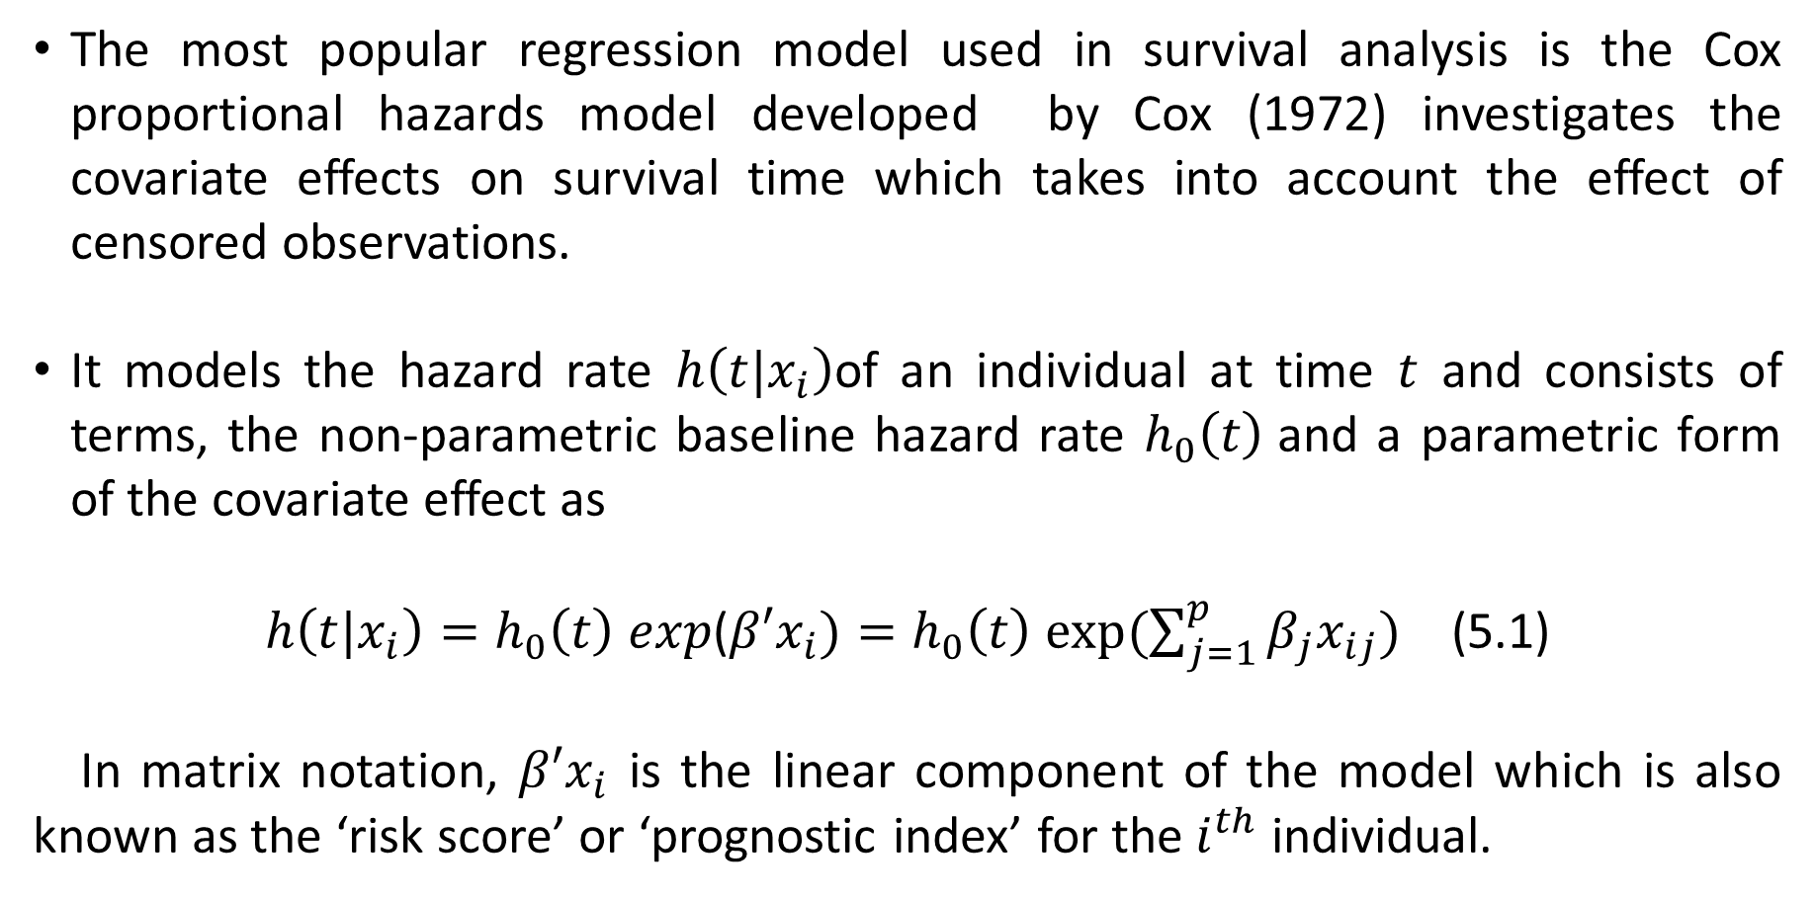
5. COX PROPORTIONAL HAZARD (CPH) MODEL
The most popular regression model used in survival analysis is the Cox proportional hazards model developed by Cox (1972) investigates the covariate effects on survival time which takes into account the effect of censored observations.
It models the hazard rate $h\left(t|x_{i}\right)$of an individual at time $t$ and consists of terms, the non-parametric baseline hazard rate $h_{0}\left(t\right)$and a parametric form of the covariate effect as
$h\left(t|x_{i}\right)=h_{0}\left(t\right) exp$($β′x_{i})=h_{0}\left(t\right) exp⁡(\sum_{j=1}^{p}{β_{j}x_{ij}})$ (5.1)
In matrix notation, $β′x_{i}$ is the linear component of the model which is also known as the ‘risk score’ or ‘prognostic index’ for the $i^{th}$ individual.

Slide 20
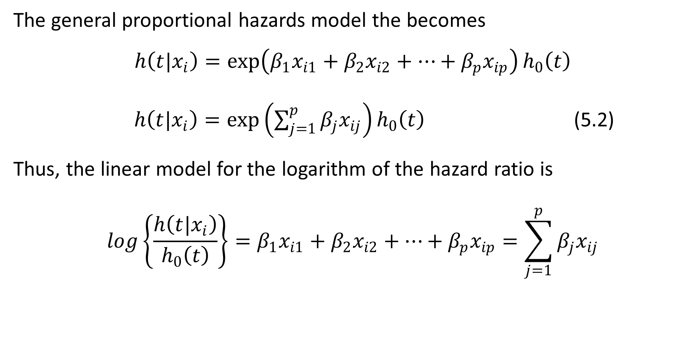
The general proportional hazards model the becomes
$$h\left(t|x_{i}\right)=\exp\left(β_{1}x_{i1}+β_{2}x_{i2}+…+β_{p}x_{ip}\right)h_{0}\left(t\right)$$
$h\left(t|x_{i}\right)=\exp\left(\sum_{j=1}^{p}{β_{j}x_{ij}}\right)h_{0}\left(t\right)$ (5.2)
Thus, the linear model for the logarithm of the hazard ratio is
$$log\left\{\frac{h\left(t|x_{i}\right)}{h_{0}\left(t\right)}\right\}=β_{1}x_{i1}+β_{2}x_{i2}+…+β_{p}x_{ip}=\sum_{j=1}^{p}{β_{j}x_{ij}}$$

Slide 21
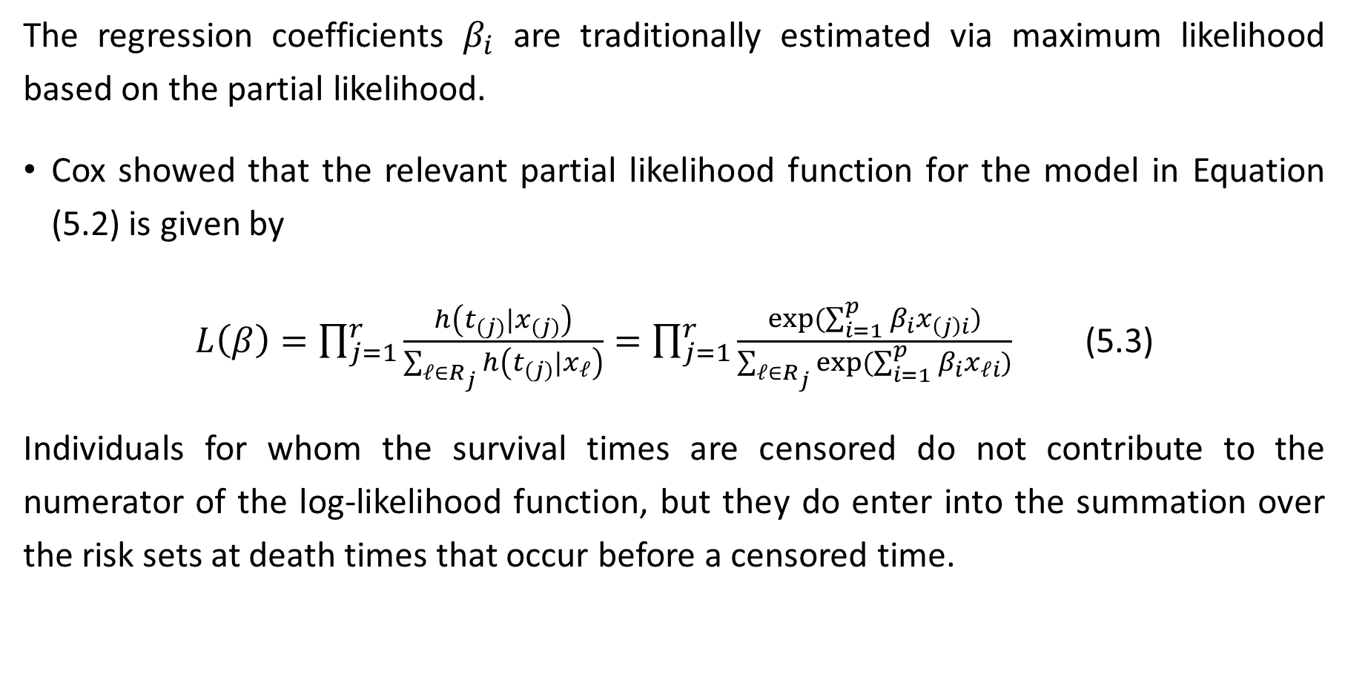
5.1 COX PARTIAL LIKELIHOOD
The regression coefficients $β_{i}$ are traditionally estimated via maximum likelihood based on the partial likelihood.
Cox showed that the relevant partial likelihood function for the model in Equation (5.2) is given by
$L\left(β\right)=\prod_{j=1}^{r}{\frac{h\left(t_{(j)}|x_{(j)}\right)}{\sum_{ℓ∈R_{j}}{h\left(t_{(j)}|x_{ℓ}\right)}}}=\prod_{j=1}^{r}{\frac{exp⁡(\sum_{i=1}^{p}{β_{i}x_{\left(j\right)i}})}{\sum_{ℓ∈R_{j}}{exp⁡(\sum_{i=1}^{p}{β_{i}x_{ℓi}})}}}$ (5.3)
Individuals for whom the survival times are censored do not contribute to the numerator of the log-likelihood function, but they do enter into the summation over the risk sets at death times that occur before a censored time.

Slide 22
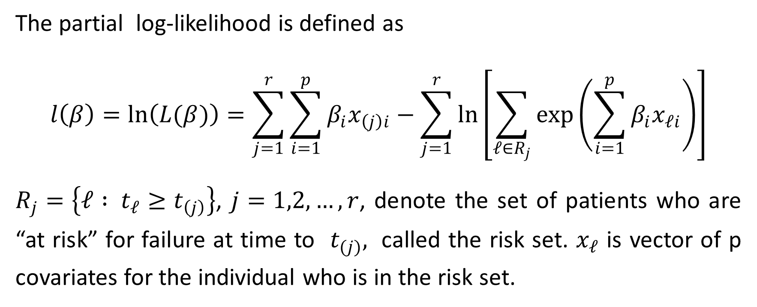
The partial log-likelihood is defined as
$$l\left(β\right)=\ln\left(L(β)\right)=\sum_{j=1}^{r}{\sum_{i=1}^{p}{β_{i}x_{\left(j\right)i}−\sum_{j=1}^{r}{\ln\left[\sum_{ℓ∈R_{j}}{\exp\left(\sum_{i=1}^{p}{β_{i}x_{ℓi}}\right)}\right]}}}$$
$R_{j}=\left\{ℓ : t_{ℓ}≥t_{\left(j\right)}\right\}$, $j=1,2,…,r$, denote the set of patients who are “at risk” for failure at time to $t_{(j)},$ called the risk set. $x_{𝓁}$ is vector of p covariates for the individual who is in the risk set.

Slide 23
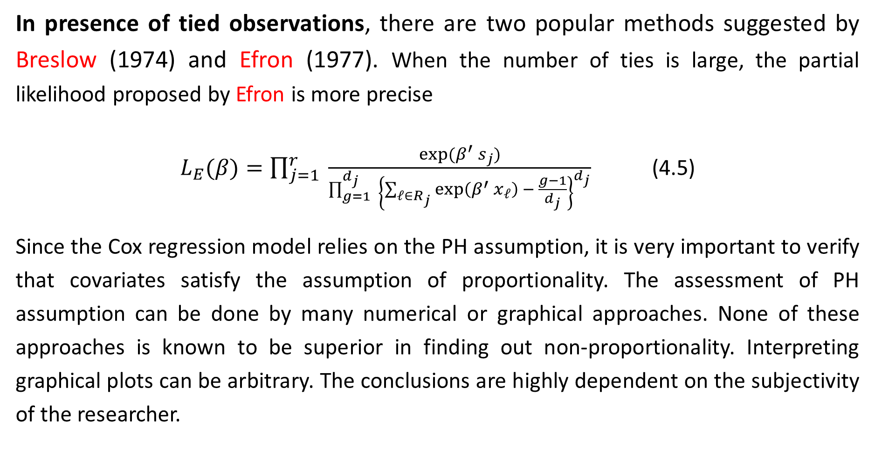
In presence of tied observations, there are two popular methods suggested by Breslow (1974) and Efron (1977). When the number of ties is large, the partial likelihood proposed by Efron is more precise
$L_{E}(β)=\prod_{j=1}^{r}{ \frac{exp⁡(β^{′} s_{j})}{\prod_{g=1}^{d_{j}}{{ \left\{\sum_{ℓ∈R_{j}}{\exp\left(β^{′} x_{ℓ}\right) − \frac{g−1}{d_{j}}}\right\}}^{d_{j}}}}}$ (4.5)
Since the Cox regression model relies on the PH assumption, it is very important to verify that covariates satisfy the assumption of proportionality. The assessment of PH assumption can be done by many numerical or graphical approaches. None of these approaches is known to be superior in finding out non-proportionality. Interpreting graphical plots can be arbitrary. The conclusions are highly dependent on the subjectivity of the researcher.

Slide 24
5.2 ESTIMATION OF KAPLAN-MEIER
The survival package is the cornerstone of the entire R survival analysis. Not only is the package itself rich in features, but the object created by the Surv() function, which contains failure time and censoring information, is the basic survival analysis data structure in R.
To begin our analysis, we use the formula
Surv(days, status) ~ .
and the survfit() function to produce the Kaplan-Meier estimates of the probability of survival over time. Using ggsurvplot() function to plot survival curves.

Slide 25
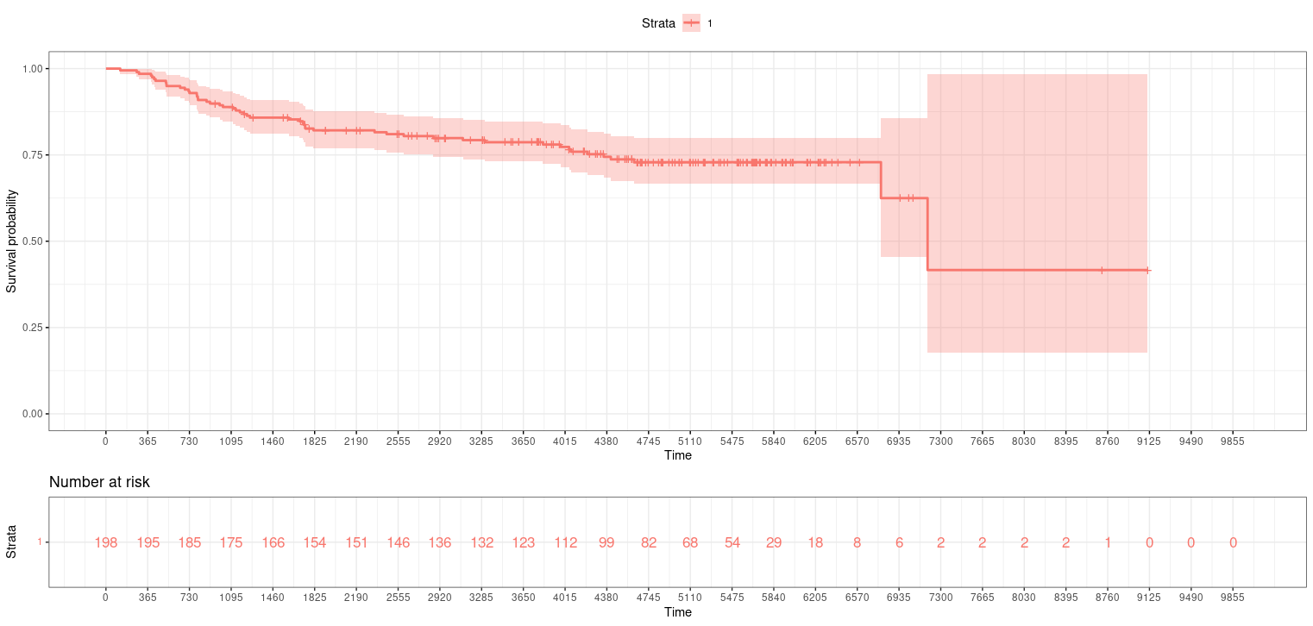
The following figure shows the Probability of survival for the patient who is dead (‘=1’) and number of patients who are at risk for every period of 365 days.

Slide 26
STUDY ON COX PROPORTIONAL HAZARD MODEL

Slide 27
6. ANALYSIS ON CPH
coxph() function, fits a Cox proportional hazards regression model. Here, an applied CPH method is ‘efron’. The proportional hazards model is usually expressed in terms of a single survival time value for each person, with possible censoring. The following is the summary of coxph() for 178 training observations that makes use of all covariates in the dataset.
After performing CPH model for training dataset, the performance of test data set is predicted by computing fitted values and regression terms for a model fitted by coxph() with type=”lp” using predict() function. This is interpreted as the individual having a lower or higher risk for survival, depending on whether the value is below zero or above zero.

Slide 28
The linear predictors for 20 test observation is,
[1] -847.152253 340.971951 -524.196853
[4] -1062.031255 460.435388 -39.030206
[7] -935.374832 -2196.101652 273.136244
[10] 2.325584 -1168.855957 98.704610
[13] 1063.406382 -597.507267 90.553627
[16] 494.187446 1367.868203 349.651086
[19] -109.332359 -770.892665

Slide 29
7. RANDOM SURVIVAL FOREST
An extension of the random forest approach to survival analysis is useful in building a risk prediction model which is a non-parametric machine learning strategy.
In this application, it is of interest to compare the predictive accuracies of Cox regression to random forest for building a risk prediction model. Several measures can be used to assess the resulting probabilistic risk predictions.
Random Forests are simply a collection of Decision Trees that have been generated using a random subset of data. The name “Random Forest” comes from combining the randomness that is used to pick the subset of data with having a bunch of decision trees, hence a forest.

Slide 30
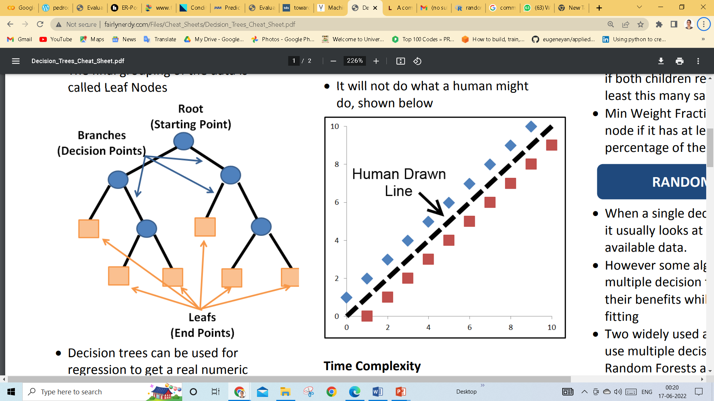
A decision tree processes data into groups based on the value of the data and the features it is provided. It describes the process of dividing a node into two or more sub-nodes.
A decision tree can also be interpreted as a series of nodes which starts with a single node called Root node, which considers all features. Decision node is defined by the result of a split.
The final grouping of the data is called Leaf Nodes, which cannot be splitted/divided any further.
Decision trees look through every possible split and pick the best split between two adjacent points in a given feature.
The split are always selected on a single feature only, not any interaction between multiple features.

Slide 31
Random Forests use a large number of slightly different decision trees run in parallel and averaged to get a final result.
They use known training data to create a process that predicts the results of that data. That process can then be used to predict the results for unknown data.
Various data splitting algorithms have been proposed, based on bootstrap, to correctly estimate the prediction accuracy of a model in the typical situation where a single data set has to be used to build the prediction models and again to estimate the prediction performance.

Slide 32
Random survival forests (RSF) does not make the proportional hazards assumption and has the flexibility to model survivor curves that are of dissimilar shapes for contrasting groups of subjects.
We applied both techniques in our selected dataset and compared their fits using prediction error curves.
The concordance index was introduced to extend RF to the setting of right-censored survival data. Implementation of RSF follows the same general principles as RF: (a) Survival trees are grown using bootstrapped data; (b) Random feature selection is used when splitting tree nodes; (c) Trees are generally grown deeply, and (d) The survival forest ensemble is calculated by averaging terminal node statistics (TNS).

Slide 33
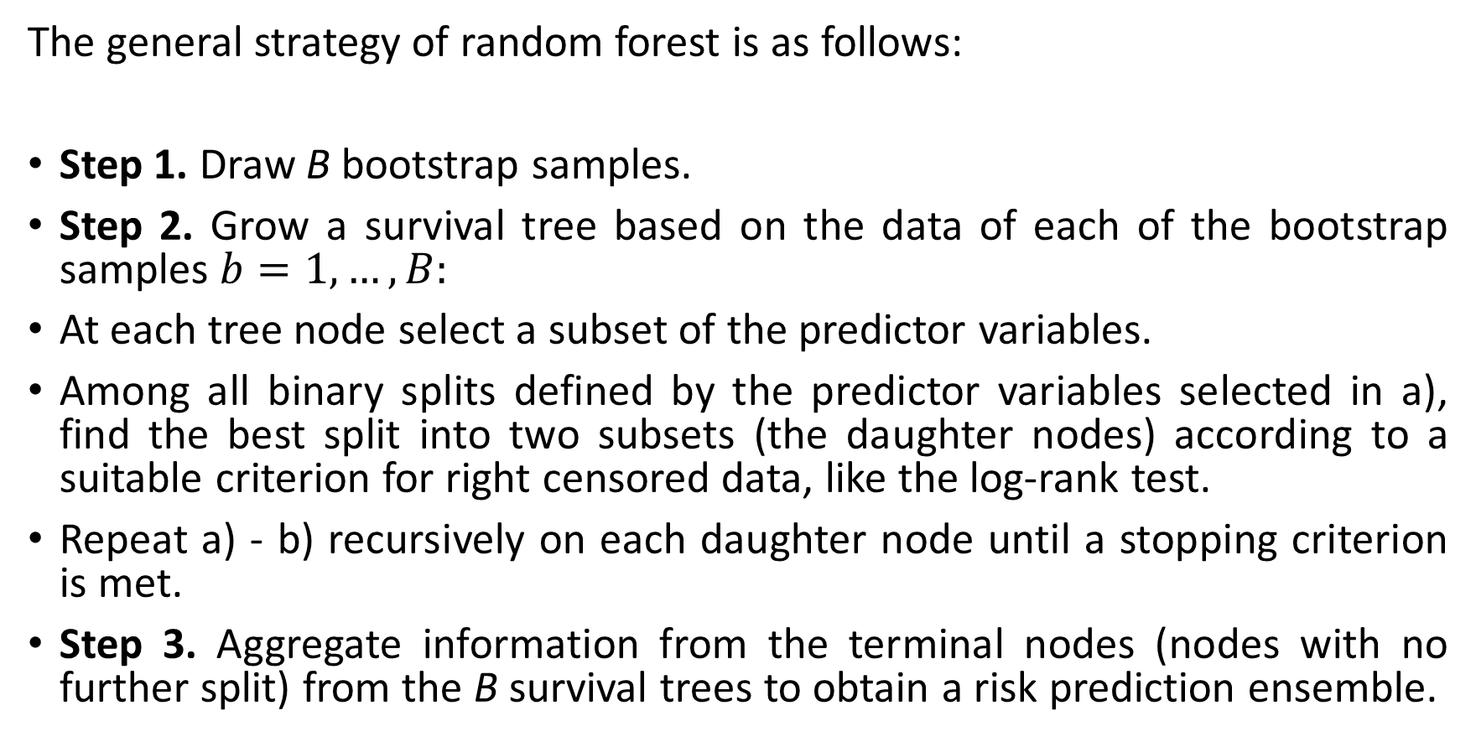
The general strategy of random forest is as follows:
Step 1. Draw B bootstrap samples.
Step 2. Grow a survival tree based on the data of each of the bootstrap samples $b=1,…,B:$
At each tree node select a subset of the predictor variables.
Among all binary splits defined by the predictor variables selected in a), find the best split into two subsets (the daughter nodes) according to a suitable criterion for right censored data, like the log-rank test.
Repeat a) - b) recursively on each daughter node until a stopping criterion is met.
Step 3. Aggregate information from the terminal nodes (nodes with no further split) from the B survival trees to obtain a risk prediction ensemble.

Slide 34
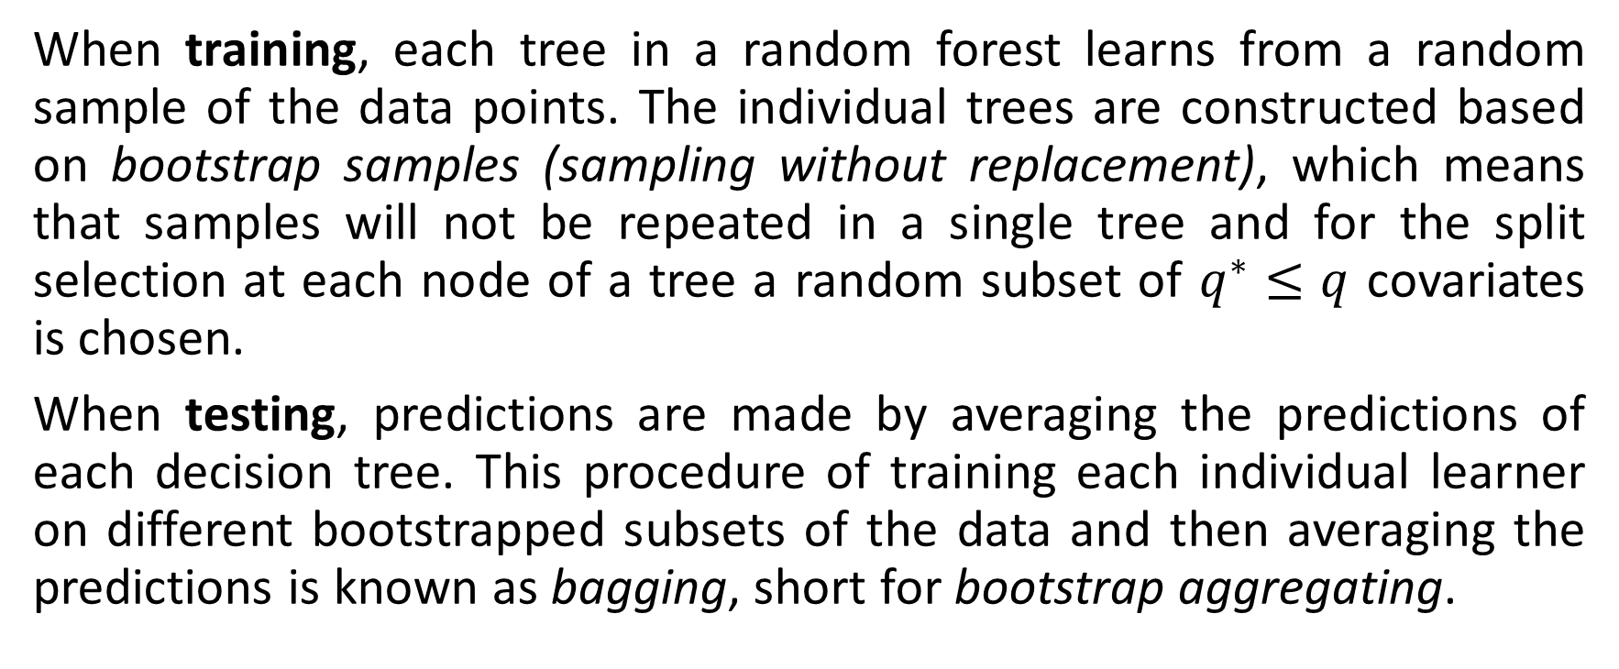
When training, each tree in a random forest learns from a random sample of the data points. The individual trees are constructed based on bootstrap samples (sampling without replacement), which means that samples will not be repeated in a single tree and for the split selection at each node of a tree a random subset of $q^{∗}≤q$ covariates is chosen.
When testing, predictions are made by averaging the predictions of each decision tree. This procedure of training each individual learner on different bootstrapped subsets of the data and then averaging the predictions is known as bagging, short for bootstrap aggregating.

Slide 35
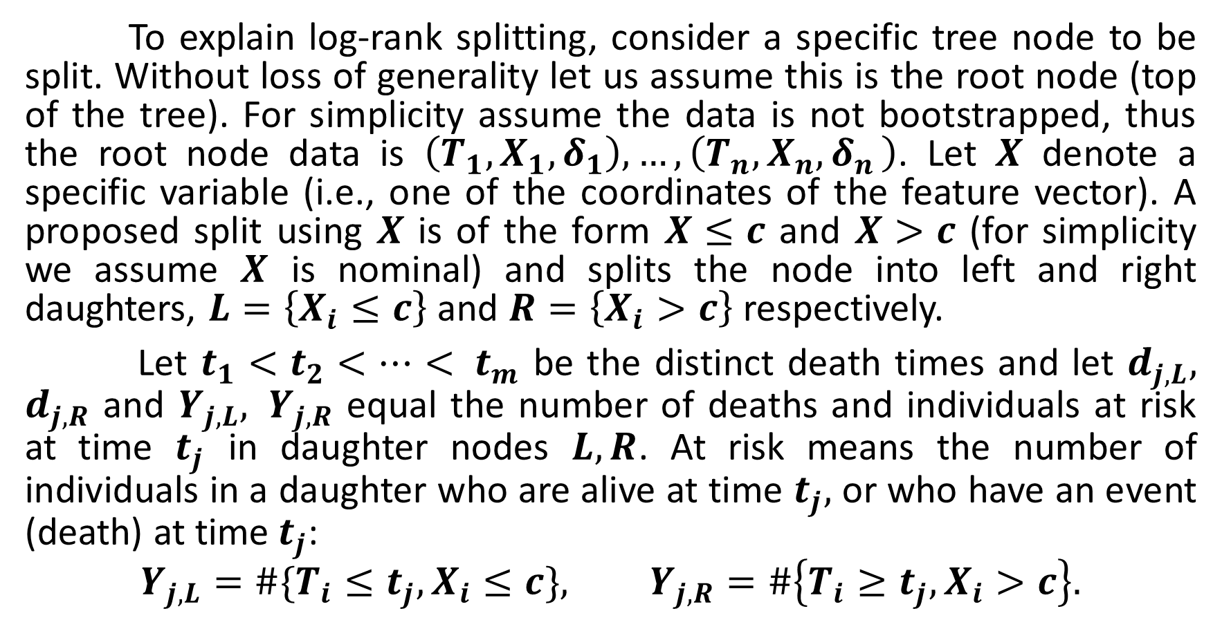
7.1 RSF LOG-RANK SPLITTING RULE
To explain log-rank splitting, consider a specific tree node to be split. Without loss of generality let us assume this is the root node (top of the tree). For simplicity assume the data is not bootstrapped, thus the root node data is $\left(T_{1}, X_{1},δ_{1}\right),…,\left(T_{n}, X_{n}{,δ}_{n}\right)$. Let $X$ denote a specific variable (i.e., one of the coordinates of the feature vector). A proposed split using $X$ is of the form $X≤c$ and $X>c$ (for simplicity we assume $X$ is nominal) and splits the node into left and right daughters, $L=\left\{X_{i}≤c\right\}$ and $R=\left\{X_{i}>c\right\}$ respectively.
Let $t_{1}<t_{2}<…< t_{m}$ be the distinct death times and let $d_{j,L}, d_{j,R}$ and $Y_{j,L}, Y_{j,R}$ equal the number of deaths and individuals at risk at time $t_{j}$ in daughter nodes $L, R$. At risk means the number of individuals in a daughter who are alive at time $t_{j},$ or who have an event (death) at time${ t}_{j}$:
$$Y_{j,L}=\#\{T_{i}≤t_{j}, X_{i}≤c\}, Y_{j,R}=\#\left\{T_{i}≥t_{j}, X_{i}>c\right\}.$$

Slide 36
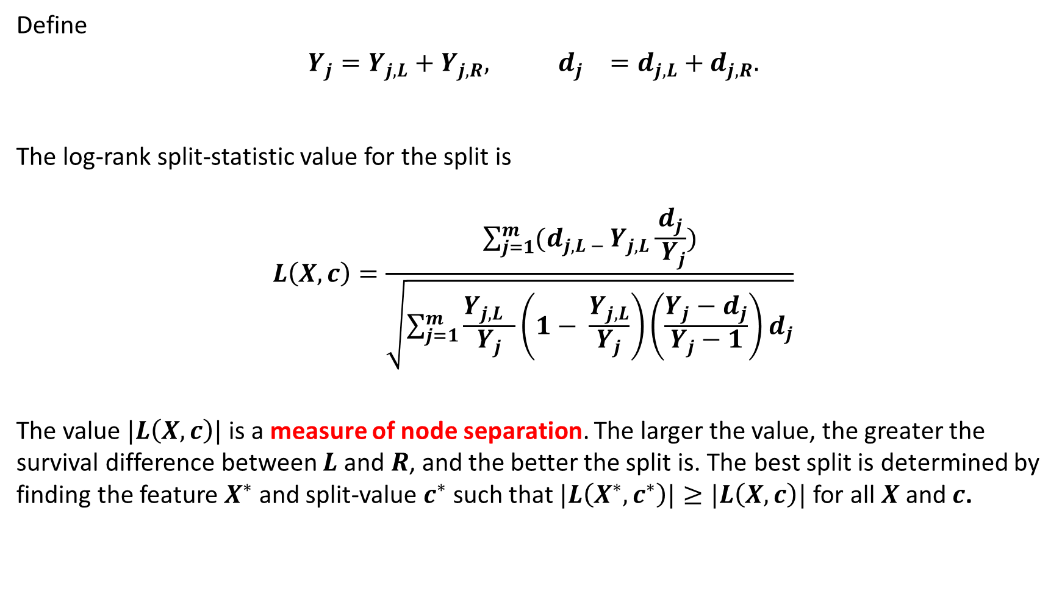
Define
$$Y_{j}=Y_{j,L}+Y_{j,R}, { d}_{j}=d_{j,L}+d_{j,R}.$$
The log-rank split-statistic value for the split is
$$L\left(X,c\right)=\frac{\sum_{j=1}^{m}{(d_{j,L − }Y_{j,L}\frac{d_{j}}{ Y_{j}})}}{\sqrt{\sum_{j=1}^{m}{\frac{Y_{j,L} }{Y_{j}}}\left(1− \frac{Y_{j,L}}{Y_{j}}\right)\left(\frac{Y_{j}−d_{j}}{Y_{j}−1}\right)d_{j}}}$$
The value $|L\left(X,c\right)|$ is a measure of node separation. The larger the value, the greater the survival difference between $L$ and $R$, and the better the split is. The best split is determined by finding the feature $X^{∗}$ and split-value $c^{∗}$ such that $|L\left(X^{∗},c^{∗}\right)|≥|L\left(X,c\right)|$ for all $X$ and $c$.

Slide 37
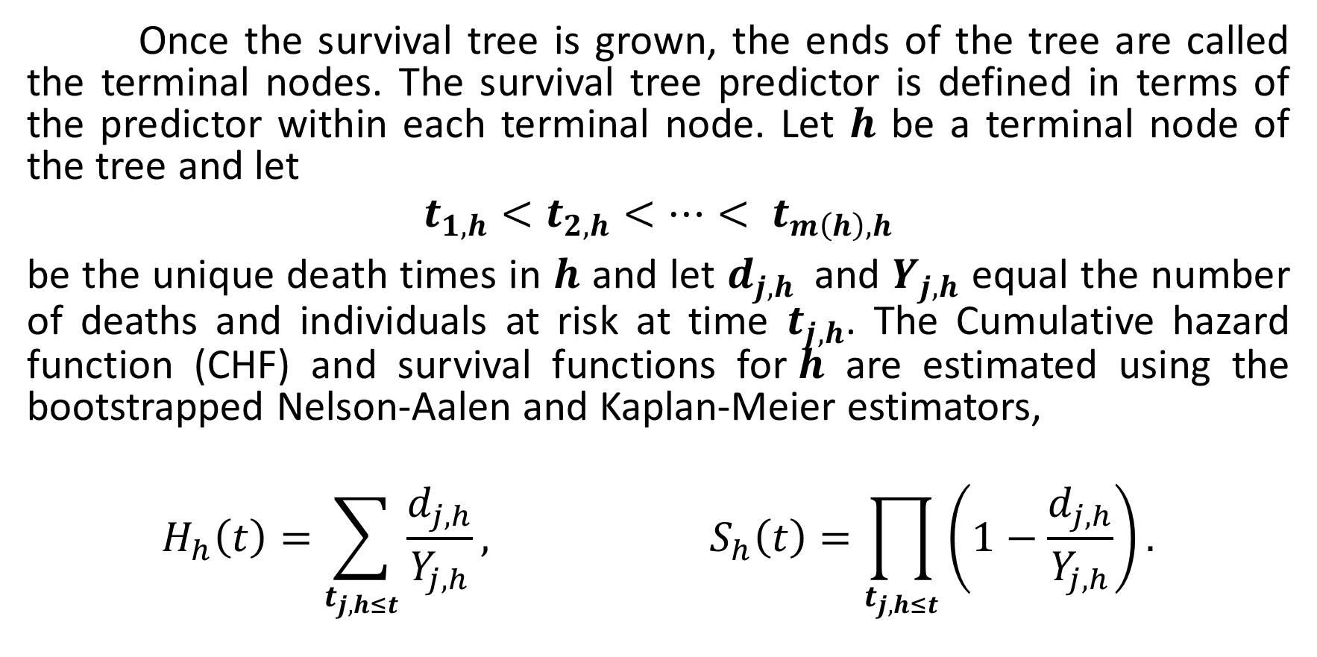
7.2 ENSEMBLE CHF AND SURVIVAL FUNCTION
Once the survival tree is grown, the ends of the tree are called the terminal nodes. The survival tree predictor is defined in terms of the predictor within each terminal node. Let $h$ be a terminal node of the tree and let
$$t_{1,h}<t_{2,h}<…< t_{m\left(h\right),h}$$
be the unique death times in $h$ and let $d_{j,h }$ and $Y_{j,h}$ equal the number of deaths and individuals at risk at time $t_{j,h}$. The Cumulative hazard function (CHF) and survival functions for$h$ are estimated using the bootstrapped Nelson-Aalen and Kaplan-Meier estimators,
$$H_{h}\left(t\right)=\sum_{t_{j,h≤t}}{\frac{d_{j,h}}{Y_{j,h}}}, S_{h}\left(t\right)=\prod_{t_{j,h≤t}}{\left(1−\frac{d_{j,h}}{Y_{j,h}}\right)}.$$

Slide 38
STUDY ON RANDOM SURVIVAL FOREST

Slide 39
8. ANALYSIS ON RSF
This section is the implementation of the random survival forests and how to generate plots for inference. The main frame is structured as a tutorial for using the randomForestSRC package for building and post-processing random survival forest models and using the ggRandomForests package for understanding how the forest is constructed. We will build a random survival forest for the considered dataset.
The rfsrc() function fits the forest. It determines the type of forest by the response supplied in the formula argument. An argument applied to this function is,
mtry = 9, number of variables to possibly split at each node is divided by 9 for regression.
ntree = 1000, number of trees.
nsplit = 800, non-negative integer specifying number of random splits for splitting a variable.
splitrule = “logrank”, log-rank splitting rule
importance = TRUE, is a method for computing VIMP.

Slide 40
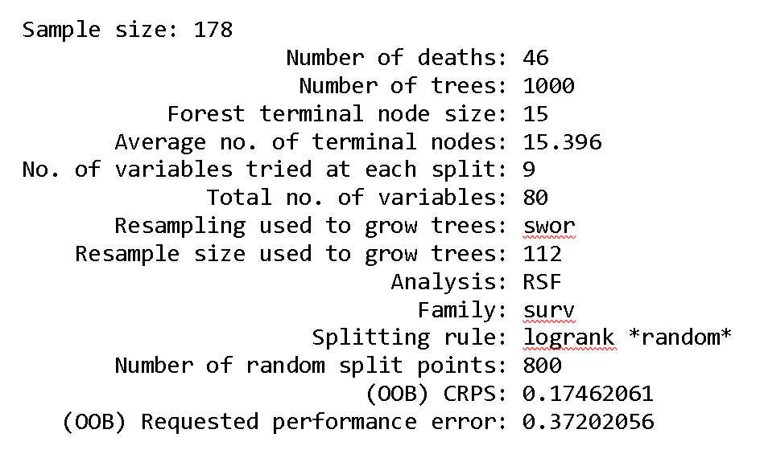
Bootstap protocol helps to grow the trees. Type of bootstrap that was used here is by.root, which is in effect of bootstrapping the data by sampling without replacement (swor; default).

Slide 41
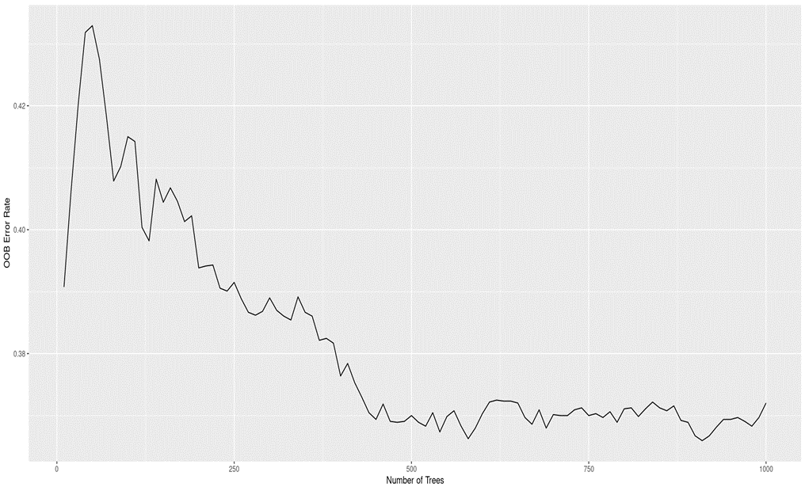
Figure 1: Shows the Number of Trees per error rate that is calculated for each observation by predicting the response over the set of trees which were not trained with that particular observation.

Slide 42
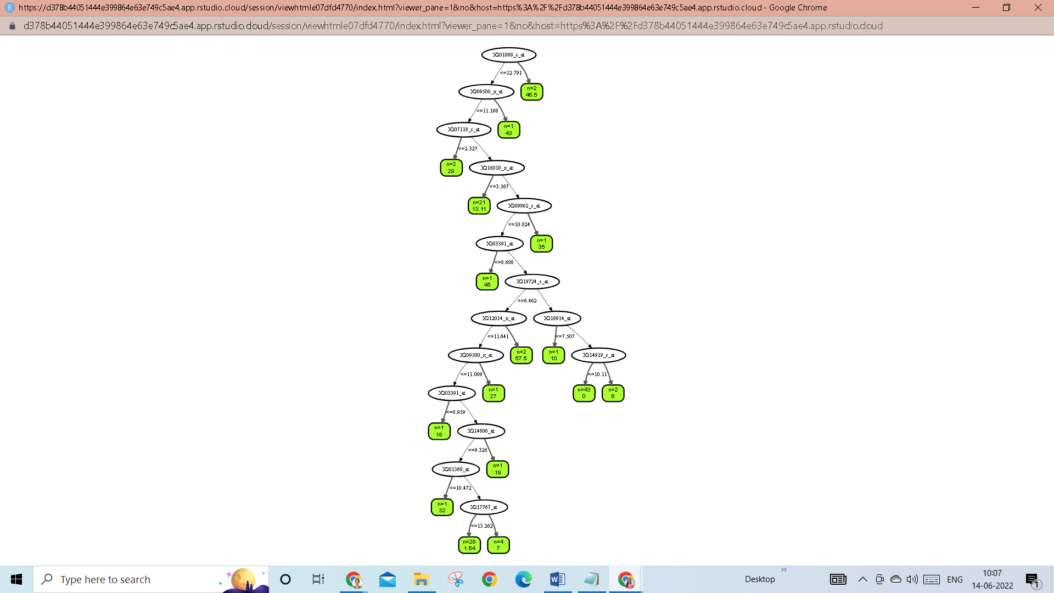
Figure 4.3: Single tree ID = 1

Slide 43
8.1 TRAINING-SET PREDICTIONS
We can now select a single patient in the training data set by using a function ggRFsrc () of ggRandomForests and determine how positive or negative estrogen receptor status would affect the survival function. Figure 4.5, Shows where censored patients are colored green, and patients who have experienced the event (death) are colored in red.

Slide 44
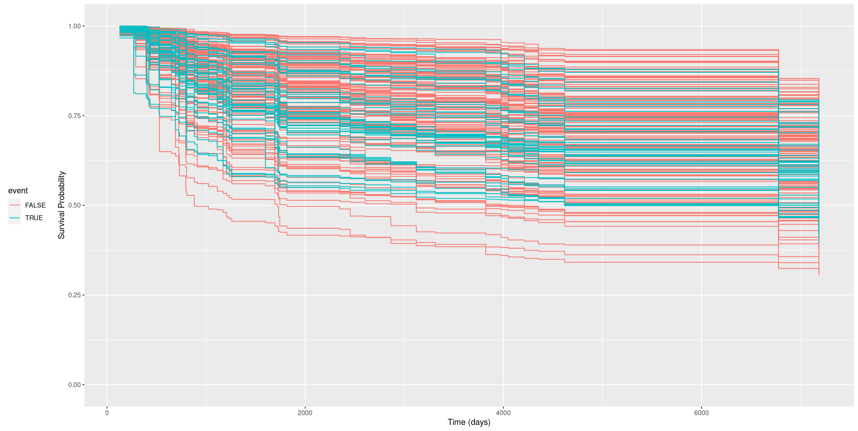
Figure 4.5: Survival Plot from RSF model for a single patient in the trial observations.

Slide 45
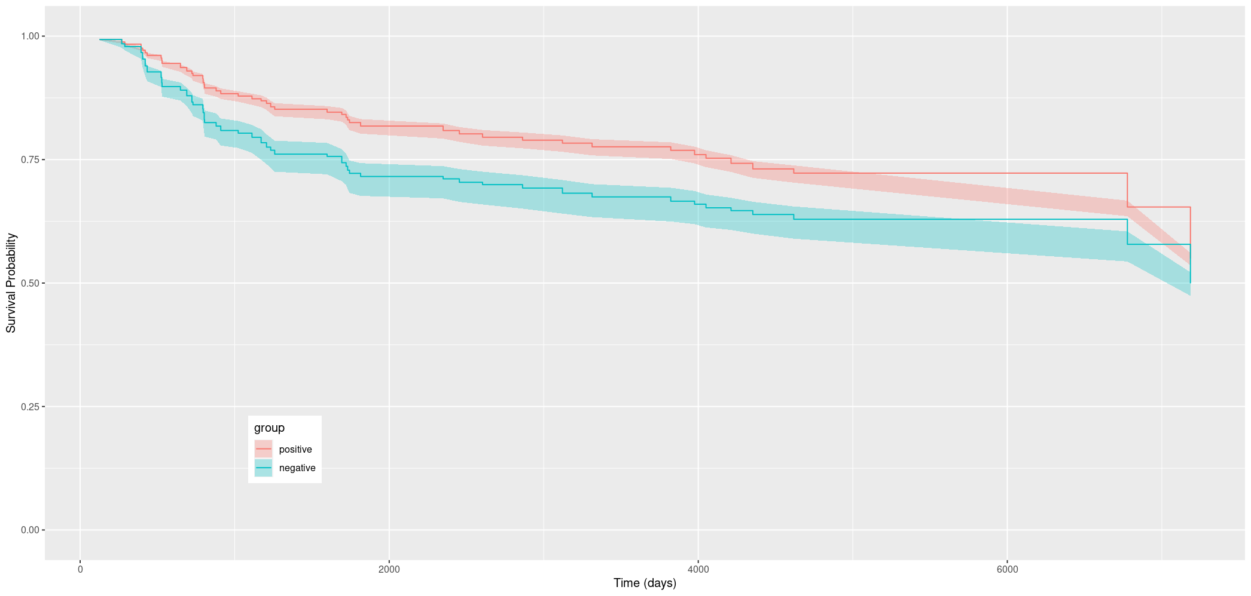
Figure 4.6: Median survival with a 95% shaded confidence band for the er-positive group in red and er-negative group in green.

Slide 46
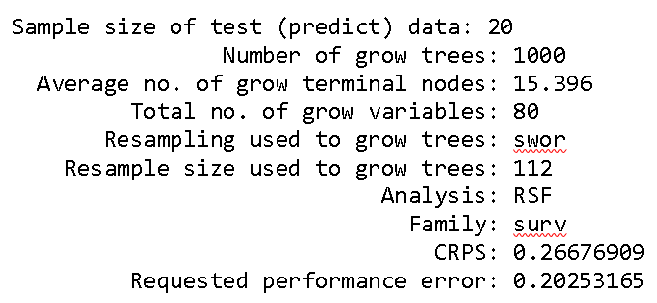
8.2 TEST-SET PREDICTIONS
The function predict.rfsrc() takes the forest object and the test data set and returns a predicted survival using the same forest within the test data set. The following outcome is received when applying this function predict.rfsrc().

Slide 47
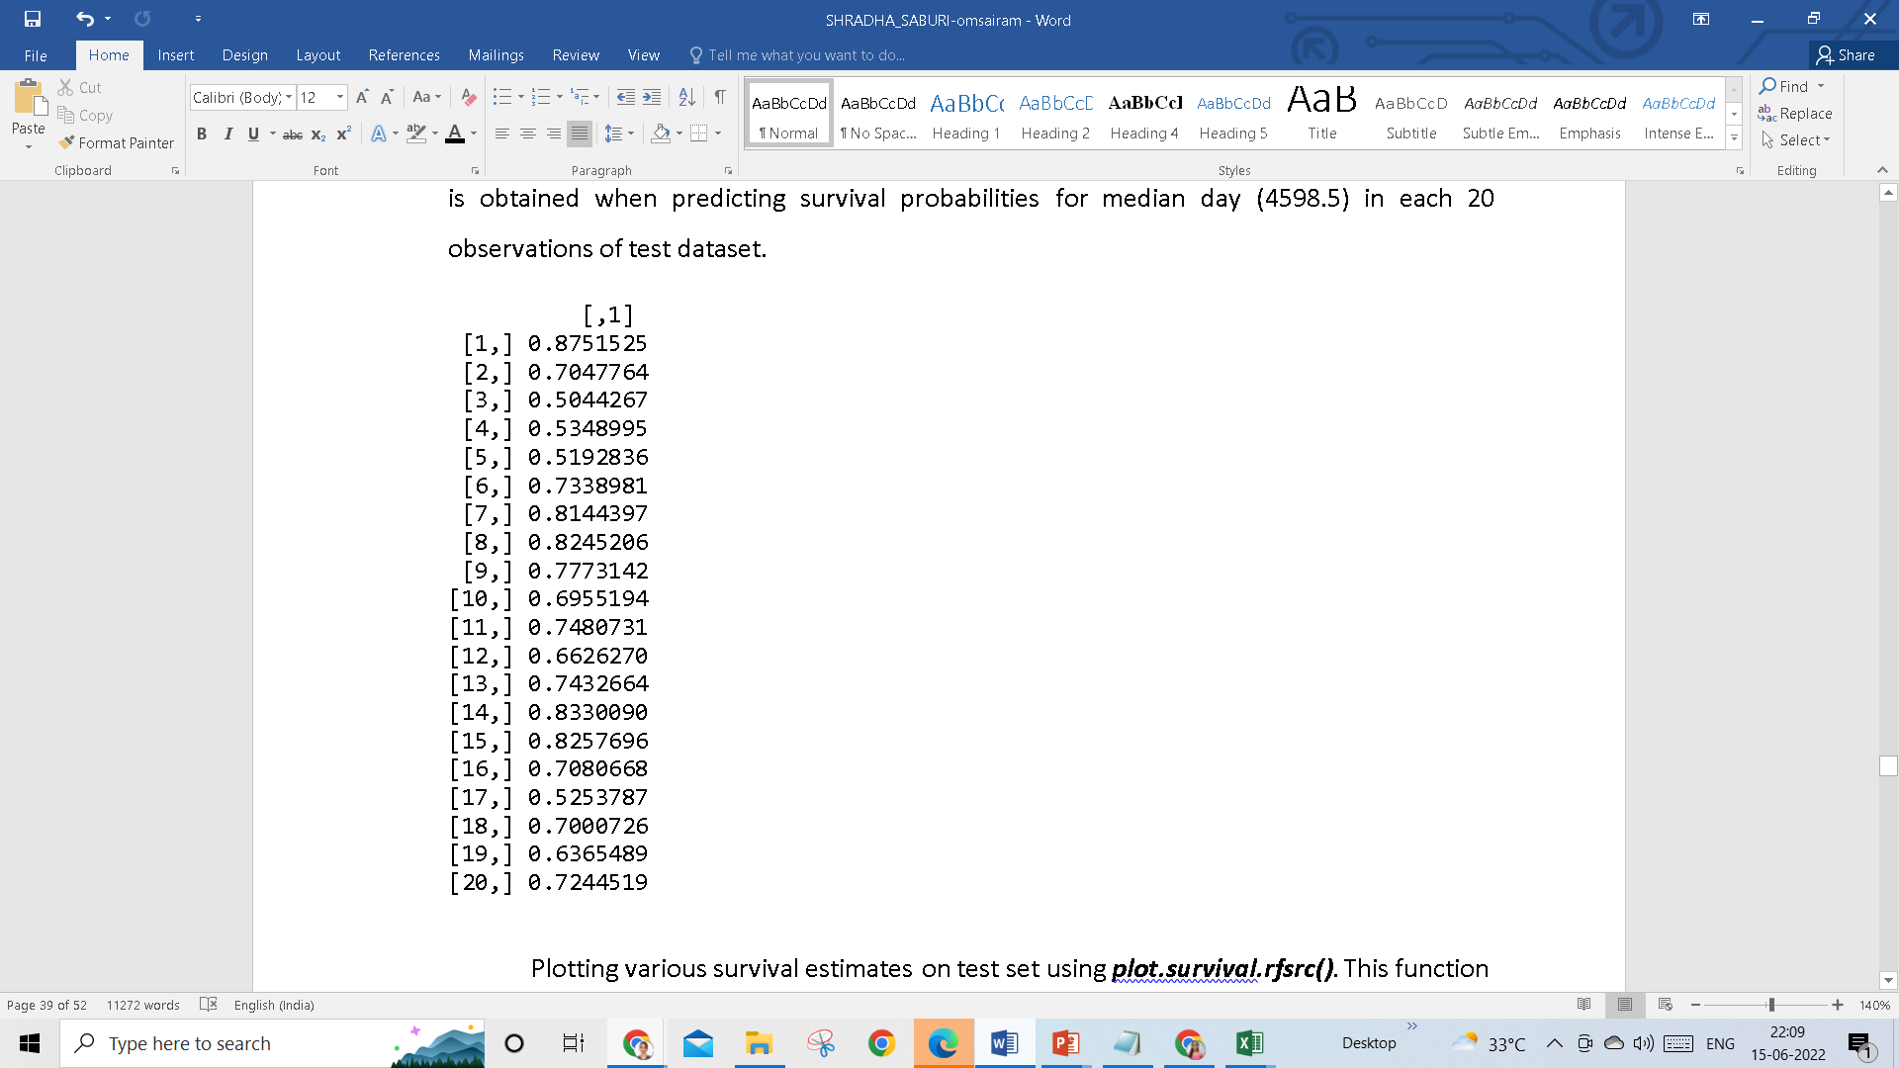
The function predictSurvProb () is employed, to foresee the survival probability predictions on this test observation.
The following result is obtained when predicting survival probabilities for median day (4598.5) in each 20 observations of test dataset.

Slide 48
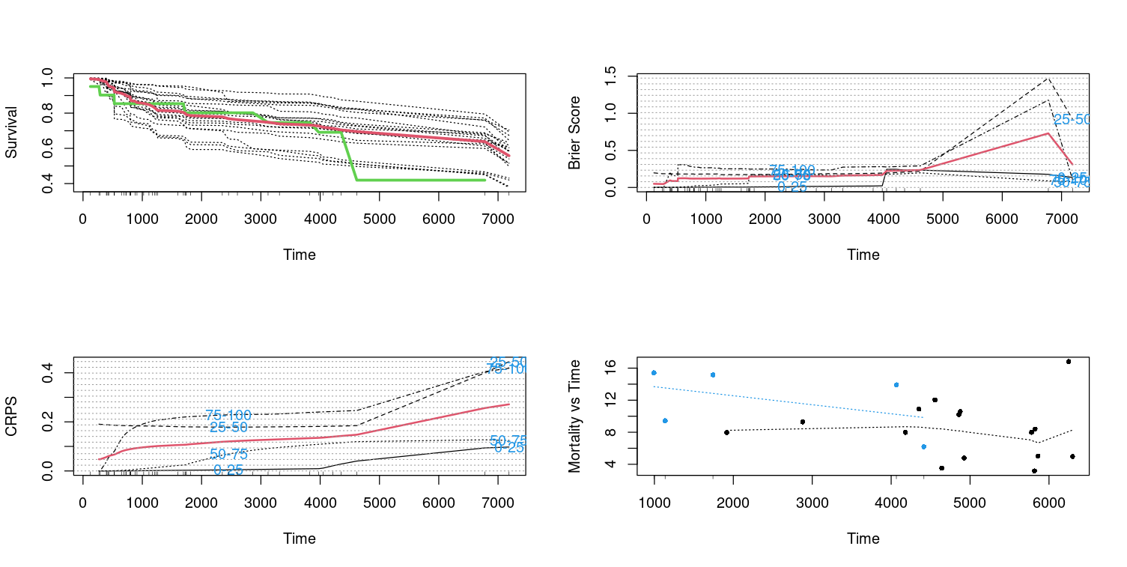
Figure 4.7: Estimated survival function on test observations.

Slide 49
Figure 4.8: Estimated Mortality rate on test observations.

Slide 50
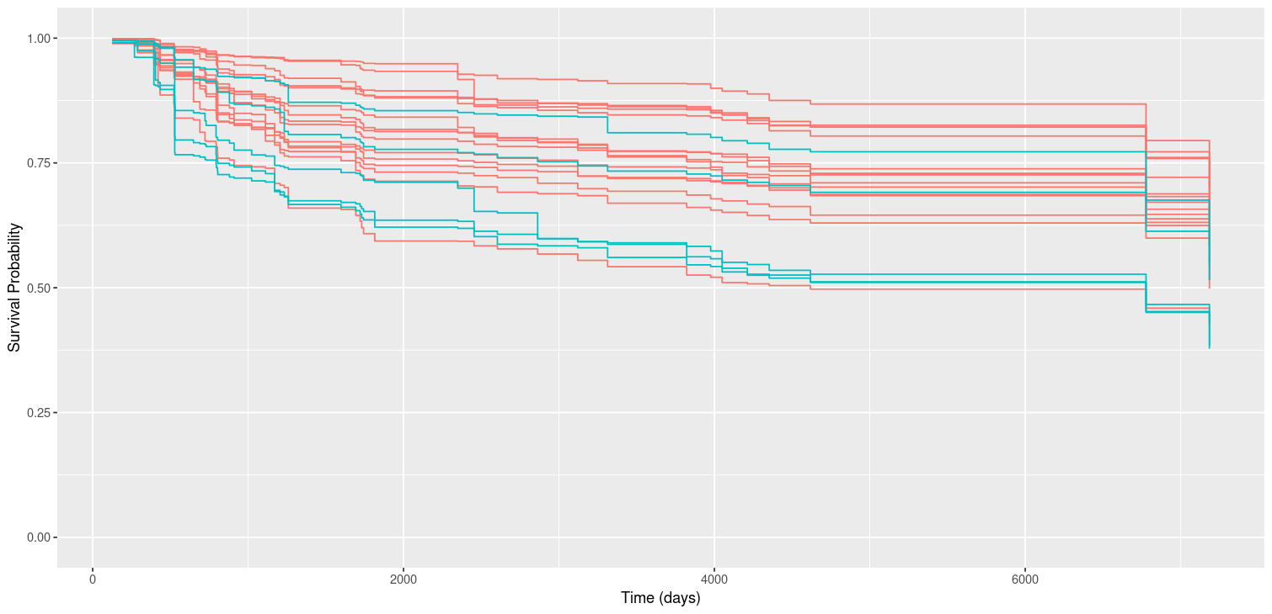
Figure 4.9: Predicted Survival Plot from RSF model for a single patient
in the test observations.

Slide 51
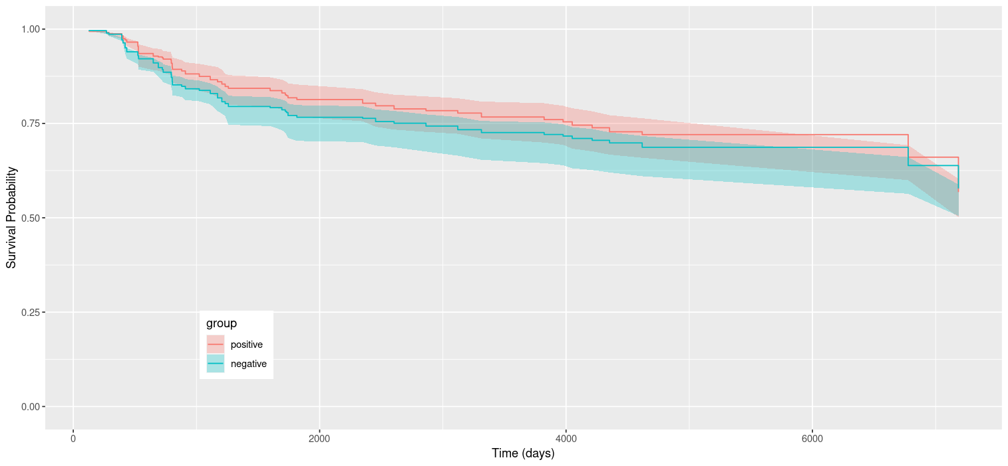

Slide 52
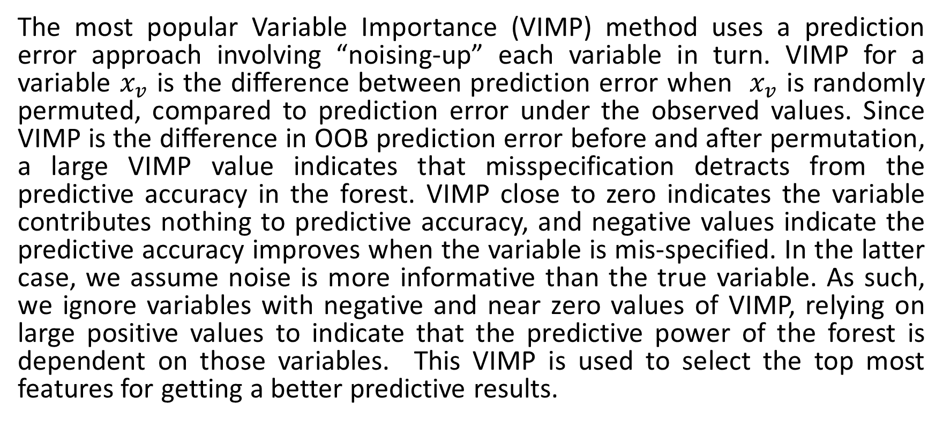
8.3 VARIABLE IMPORTANCE IN RSF
The most popular Variable Importance (VIMP) method uses a prediction error approach involving “noising-up” each variable in turn. VIMP for a variable $x_{v}$ is the difference between prediction error when $x_{v}$ is randomly permuted, compared to prediction error under the observed values. Since VIMP is the difference in OOB prediction error before and after permutation, a large VIMP value indicates that misspecification detracts from the predictive accuracy in the forest. VIMP close to zero indicates the variable contributes nothing to predictive accuracy, and negative values indicate the predictive accuracy improves when the variable is mis-specified. In the latter case, we assume noise is more informative than the true variable. As such, we ignore variables with negative and near zero values of VIMP, relying on large positive values to indicate that the predictive power of the forest is dependent on those variables. This VIMP is used to select the top most features for getting a better predictive results.

Slide 53
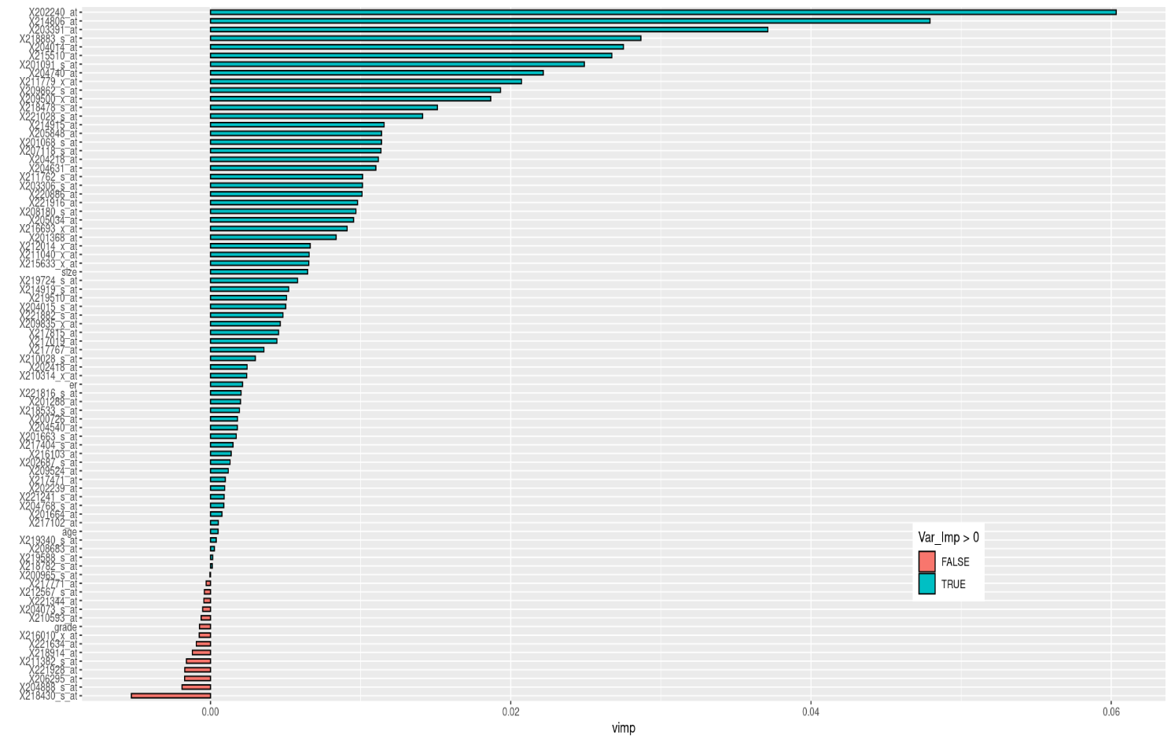

Slide 54
9. PREDICTION PERFORMANCE
9.1 C-index
The C-index measures predictive information derived from a set of predictor variables in a model. In predicting the time until death, C is calculated by considering all possible pairs of patients, at least one of whom has died.
If the predicted survival time is larger for the patient who lived longer, the predictions for that pair are said to be concordant with the outcomes. If one patient died and the other is known to have survived at least to the survival time of the first, the second patient is assumed to outlive the first.
When predicted survivals are identical for a patient pair, rather than 1 is added to the count of concordant pairs in the numerator of C. In this case, one is still added to the denominator of C (such patient pairs are still considered usable). A patient pair is unusable if both patients died at the same time, or if one died and the other is still alive but has not been followed long enough to determine whether she will outlive the one who died.

Slide 55
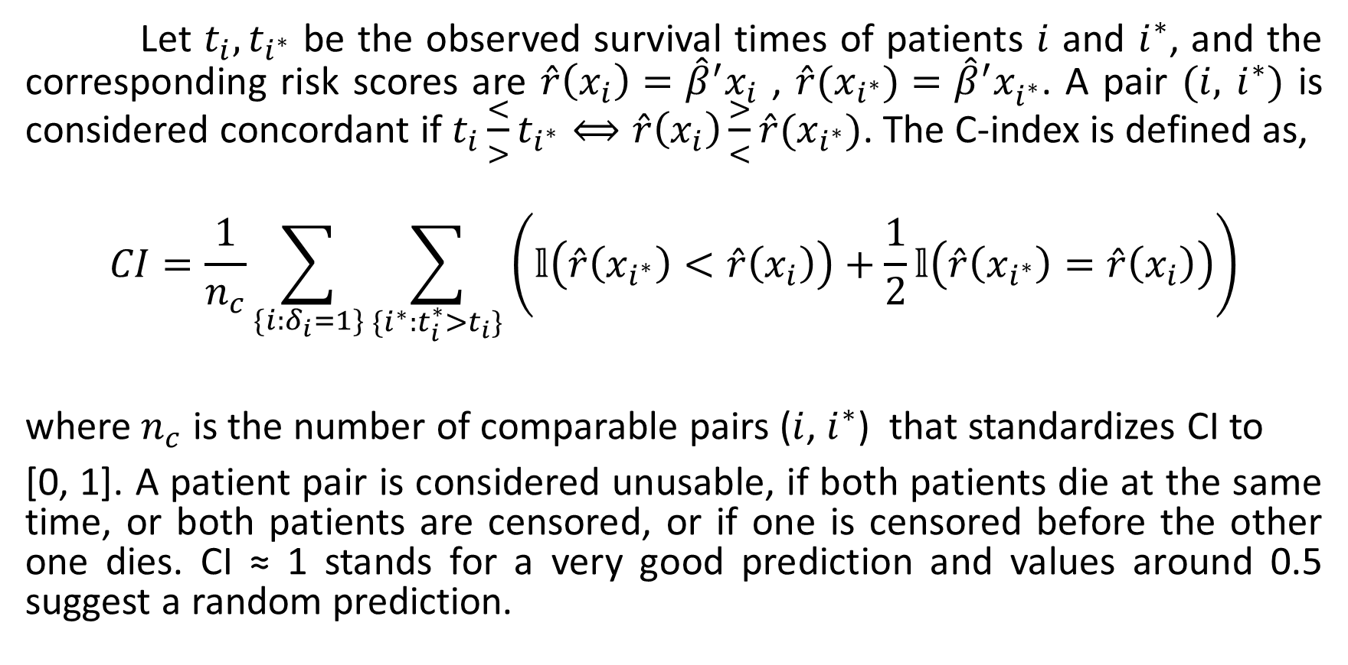
Let $t_{i}, t_{i^{∗}}$ be the observed survival times of patients $i$ and $i^{∗}$, and the corresponding risk scores are $\hat{r}\left(x_{i}\right)={\hat{β}}^{′}x_{i}$ , $\hat{r}(x_{i^{∗}})={\hat{β}}^{′}x_{i^{∗}}^{ }$. A pair $(i,$ $i^{∗})$ is considered concordant if $t_{i}\frac{<}{>}t_{i^{∗}}⟺\hat{r}\left(x_{i}\right)\frac{>}{<}\hat{r}(x_{i^{∗}})$. The C-index is defined as,
$$CI=\frac{1}{n_{c}}\sum_{\{i:δ_{i}=1\}}{\sum_{\{i^{∗}:t_{i}^{∗}>t_{i}\}}{\left(𝕝\left(\hat{r}\left(x_{i^{∗}}\right)<\hat{r}\left(x_{i}\right)\right)+\frac{1}{2}𝕝\left(\hat{r}\left(x_{i^{∗}}\right)=\hat{r}\left(x_{i}\right)\right)\right)}}$$
where $n_{c}$ is the number of comparable pairs ($i$, $i^{∗}$) that standardizes CI to
[0, 1]. A patient pair is considered unusable, if both patients die at the same time, or both patients are censored, or if one is censored before the other one dies. CI ≈ 1 stands for a very good prediction and values around 0.5 suggest a random prediction.

Slide 56
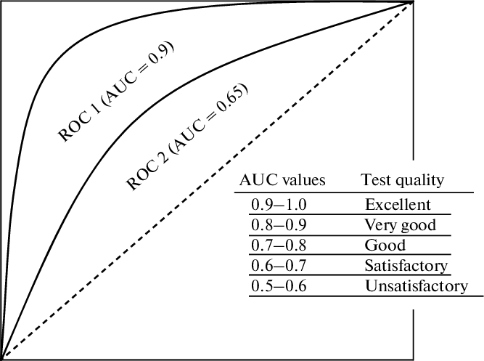
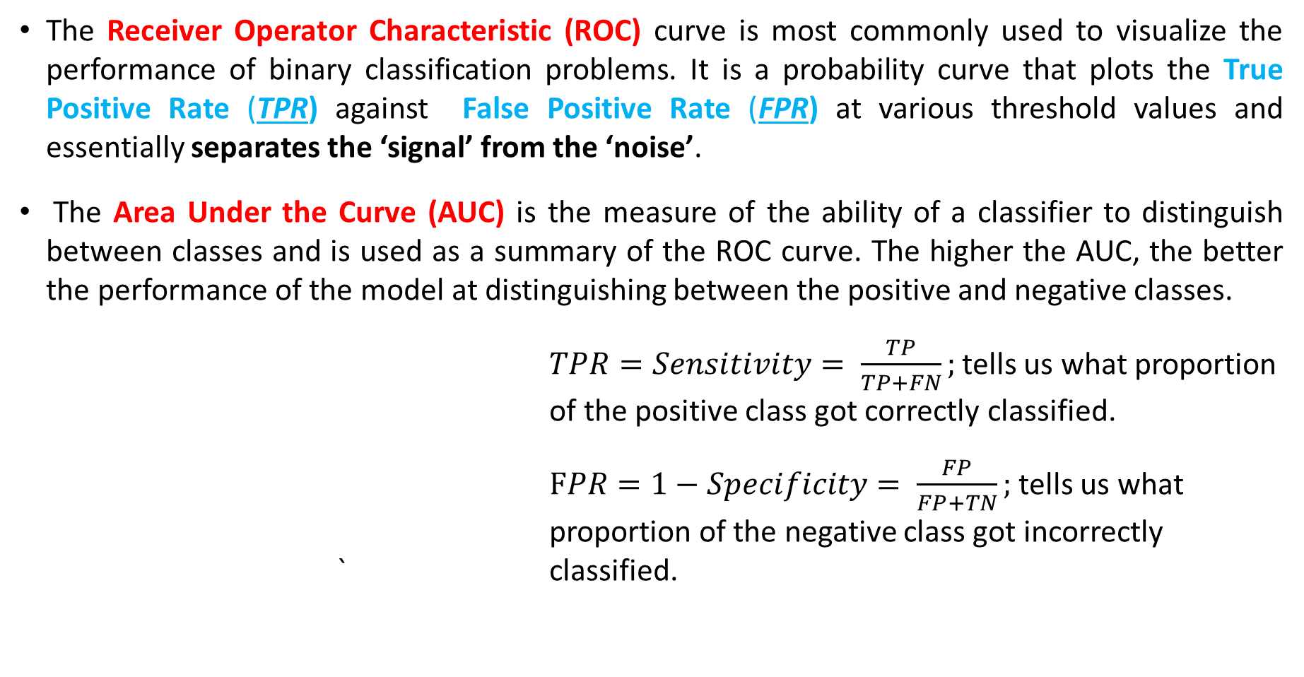
9.2 EVALUATION METRIC
The Receiver Operator Characteristic (ROC) curve is most commonly used to visualize the performance of binary classification problems. It is a probability curve that plots the True Positive Rate (TPR) against False Positive Rate (FPR) at various threshold values and essentially separates the ‘signal’ from the ‘noise’.
The Area Under the Curve (AUC) is the measure of the ability of a classifier to distinguish between classes and is used as a summary of the ROC curve. The higher the AUC, the better the performance of the model at distinguishing between the positive and negative classes.
$TPR=Sensitivity= \frac{TP}{TP+FN};$ tells us what proportion of the positive class got correctly classified.
$FPR=1−Specificity= \frac{FP}{FP+TN};$ tells us what proportion of the negative class got incorrectly ` classified.
Sensitivity
1- specificity

Slide 57
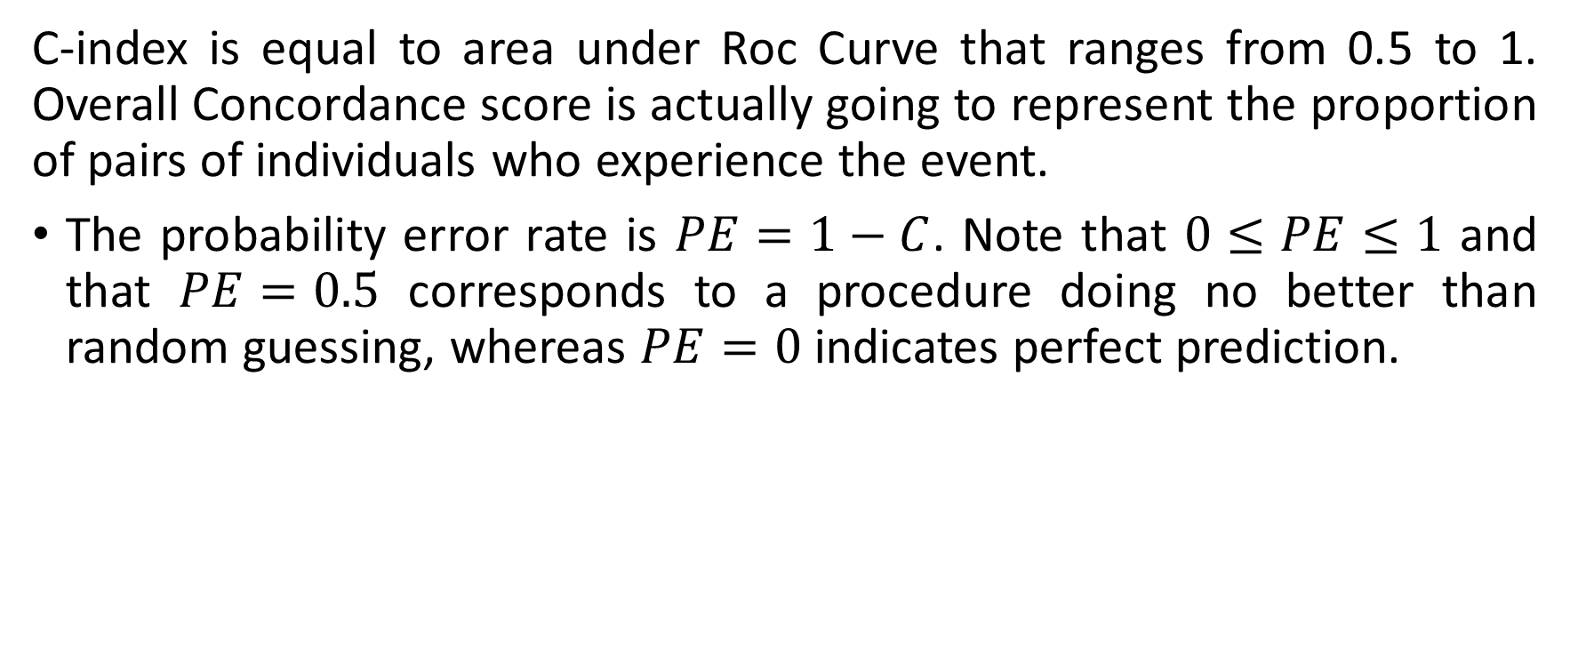
C-index is equal to area under Roc Curve that ranges from 0.5 to 1. Overall Concordance score is actually going to represent the proportion of pairs of individuals who experience the event.
The probability error rate is $PE=1−C$. Note that $0≤PE≤1$ and that $PE=0.5$ corresponds to a procedure doing no better than random guessing, whereas $PE=0$indicates perfect prediction.

Slide 58
10. Comparison of CPH and RSF on Predictive ability
In CPH model, obtained linear predictor of the test model is used as a marker to plot SurvivalROC() helps to give the probability of AUC. It creates time-dependent ROC curve estimation from censored survival data using the Kaplan Meier (KM) or Nearest Neighbor Estimation (NNE) method. Survival probability obtained on test set is 0.7272, for death (=1) time.
In RSF model, we obtain error rate corresponding to the number of trees by using $err.rate and $ntree. The C-Index is obtained by using rcorr.cens() function. This is equal to 1 - error rate. Here, risksetROC() library provides functions to compute a ROC curve and its associated Area Under Curve (AUC) in a time-dependent context. Let’s see predictive ability of OOB samples (in testing set) at median time. We must be careful about method as, depending on assumptions, but let’s assume we meet Cox’s proportional hazards assumption. Figure 4, represents OOB Survival ROC Curve at median days, 1000 days, 2000 days, 3000 days, and 5000 days.

Slide 59
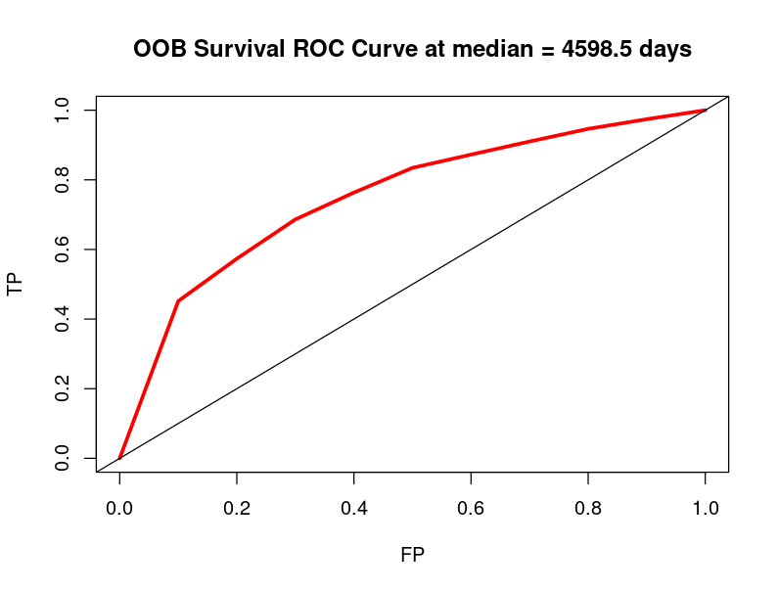
AUC = 0.7513

Slide 60
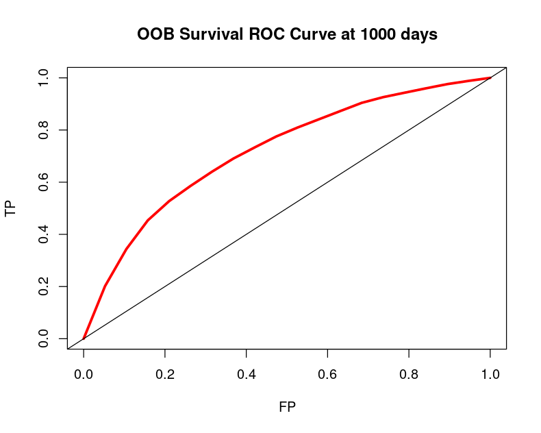
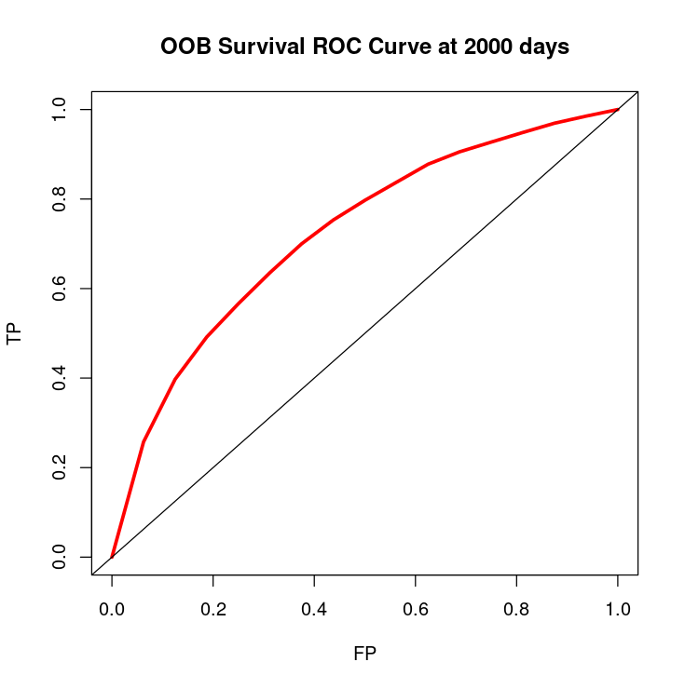
AUC = 0.7197
AUC = 0.7220

Slide 61

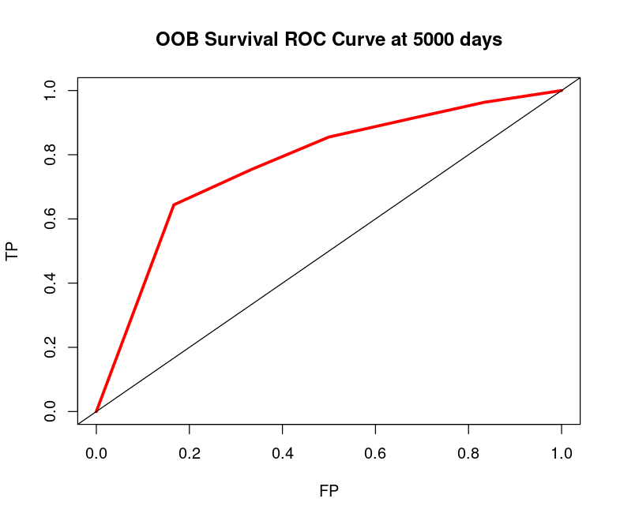
AUC = 0.7285
AUC = 0.7710

Slide 62
PERFORMANCE FOR AUC ON THE TEST SET
AUC on the new test dataset (20 observations) is an average computation of true positive Rates over all possible values of the false positive rate.
Model | Time (days)
 | Median Time = 4598.5
CPH | 0.7130
RSF | 0.7513

Slide 63
Performance for risk prediction for the test set
The Concordance-Index (C-Index) on the new test dataset (20 observations) is the computation of an agreement between an observed response and a predictor.
Model | C- Index
 | Test
CPH | 0.7215
RSF | 0.7975
Based on all these evaluation measures, it can be inferred that RSF method improves survival prediction accuracy when compared to CPH method. Thus, RSF model outperforms the CPH model.

Slide 64
11. CONCLUSION
This study indicated a superior accuracy of RSF model as compared to CPH present better fit to predict survival probability when feeding into a new observation. Prognosis prediction plays a critical role in clinical and personal decision-making for cancer patients. There have been attempts to conduct traditional statistics and ML methodology to predict individual survival. CPH and RSF model are extensively used in application of cancer survival that generally refers to time-to-event censored data. Our primary motivation to compare the performance between CPH and RSF model in using the 76-gene expression breast cancer dataset in identifying a statistical model to predict overall survival effectively based on a set of covariates. Our results showed that RSF model present better fit to predict new dataset.

Slide 65
The main advantage of our study is that it approached progression prediction based on a time-to-event dataset. According to Harrell’s concordance index, RSF based on approximate log-rank splitting rule determined major risk factors for survival which shows a slightly better performance than CPH approach. RSF is an attractive method when the goal is to do prediction. Its advantage is more apparent when the dimension of covariates is large, relationship between response and covariates are complex or when the proportional hazard assumption is at risk. Although RSF acts as a great alternative in analysing time-to-event data, it is worth nothing that interpretability is burdensome and that care must be taken when choosing and tuning the trees based on the form of available data.

Slide 66
References:
Fast Unified Random Forests with randomForestSRC, Random Survival Forest by Hemant Ishwaran, Michael S. Lauer, Eugene H. Blackstone, Min Lu, Udaya B. Kogalur, 2022-06-01. https://www.randomforestsrc.org/index.html
ggRandomForests: Exploring Random Forest Survival John Ehrlinger Microsoft arXiv:1612.08974v1 [stat.CO] 28 Dec 2016
https://aacrjournals.org/clincancerres/article/13/11/3207/193398/Strong-Time-Dependence-of-the-76-Gene-Prognostic
https://cran.r-project.org/web/packages/randomForestSRC/randomForestSRC.pdf
RANDOM SURVIVAL FORESTS, By Hemant Ishwaran, Udaya B. Kogalur, Eugene H. Blackstone and Michael S. Lauer Cleveland Clinic, Columbia University, Cleveland Clinic and National Heart, Lung, and Blood Institute. DOI: 10.1214/08-AOAS169
Shu Jiang, Prediction Based on Random Survival Forest. Am J Biomed Sci & Res. 2019 - 6(2). AJBSR.MS.ID.001005. DOI: 10.34297/AJBSR.2019.06.001005.
Strobl, C., Boulesteix, AL., Kneib, T. et al. Conditional variable importance for random forests. BMC Bioinformatics 9, 307 (2008). https://doi.org/10.1186/1471-2105-9-307
Zhou D. Prognostic factors and predictions of survival data using cox ph models and random survival forest approaches. Biom Biostat Int J. 2017;5(5):165-181. DOI: 10.15406/bbij.2017.05.00142

Slide 67
THANKYOU!!!

